Slide 1
Visualization of a dynamic map with its own time and displaying street lighting in real time.
Toleubayev Ayan, Makpal Serikkaliyeva

Slide 2
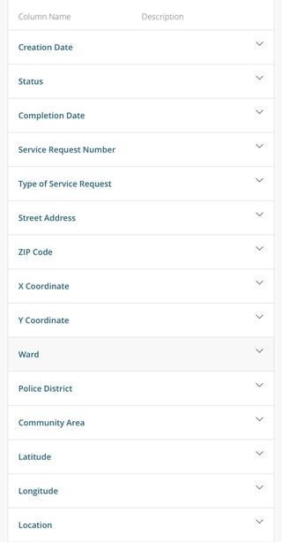
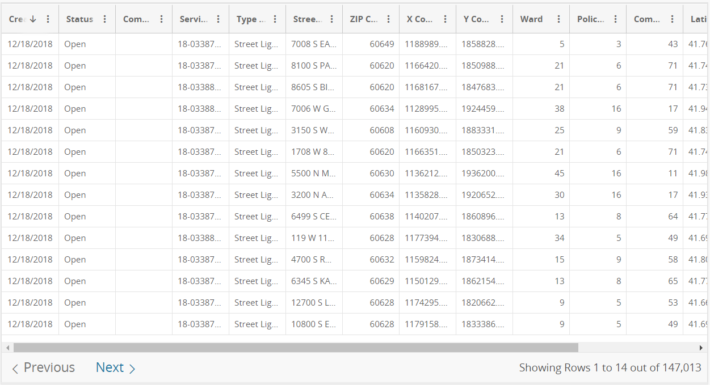
Dataset

Slide 3
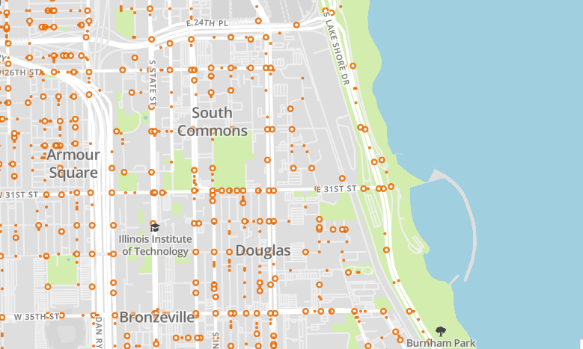

Filter
All
On
Off
+
Info:
Off: 3 days
-
On
Off
68%
32%

Slide 4
